Slide 1
Assignment on arraylist
From
pavankalyan
To
karun

Slide 2
Collections in Java
The Collection in Java is a framework that provides an architecture to store and manipulate the group of objects.
Java Collections can achieve all the operations that you perform on a data such as searching, sorting, insertion, manipulation, and deletion.

Slide 3
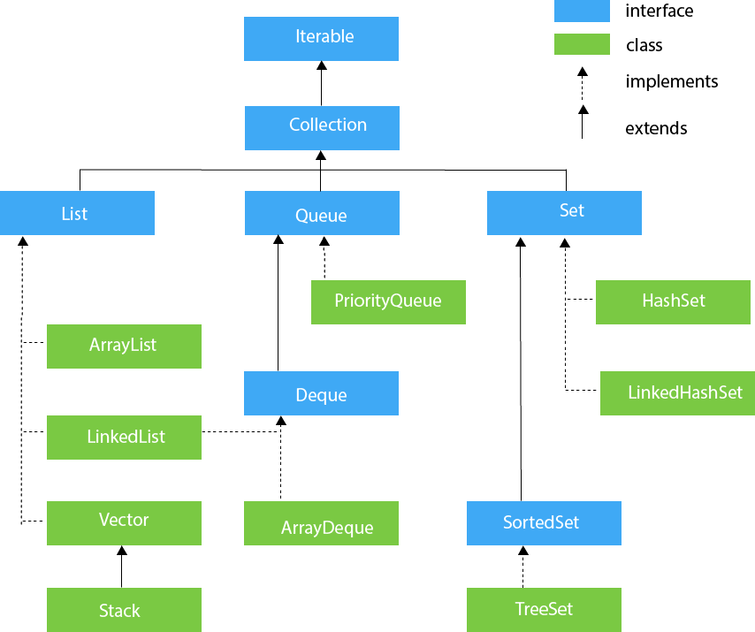

Slide 4
Java ArrayList
Java ArrayList class can contain duplicate elements.
Java ArrayList class maintains insertion order.
Java ArrayList class is non synchronized.
Java ArrayList allows random access because the array works on an index basis.

Slide 5
Java ArrayList Example
import java.util.*;
public class ArrayListExample1{
public static void main(String args[]){
ArrayList<String> list=new ArrayList<String>();//Creating arraylist
list.add("Mango");//Adding object in arraylist
list.add("Apple");
list.add("Banana");
list.add("Grapes");
//Printing the arraylist object
System.out.println(list);
}
}

Slide 6
import java.util.*;
public class ArrayListExample2{
public static void main(String args[]){
ArrayList<String> list=new ArrayList<String>();//Creating arraylist
list.add("Mango");//Adding object in arraylist
list.add("Apple");
list.add("Banana");
list.add("Grapes");
//Traversing list through Iterator
Iterator itr=list.iterator();//getting the Iterator
while(itr.hasNext()){//check if iterator has the elements
System.out.println(itr.next());//printing the element and move to next
}
}
}

Slide 7
Get and Set ArrayList .
import java.util.*;
public class ArrayListExample4{
public static void main(String args[]){
ArrayList<String> al=new ArrayList<String>();
al.add("Mango");
al.add("Apple");
al.add("Banana");
al.add("Grapes");
//accessing the element
System.out.println("Returning element: "+al.get(1));//it will return the 2nd element, because index starts from 0
//changing the element
al.set(1,"Dates");
//Traversing list
for(String fruit:al)
System.out.println(fruit);
}
}

Slide 8
Java ArrayList example of retainAll() method
import java.util.*;
class ArrayList9{
public static void main(String args[]){
ArrayList<String> al=new ArrayList<String>();
al.add("Ravi");
al.add("Vijay");
al.add("Ajay");
ArrayList<String> al2=new ArrayList<String>();
al2.add("Ravi");
al2.add("Hanumat");
al.retainAll(al2);
System.out.println("iterating the elements after retaining the elements of al2");
Iterator itr=al.iterator();
while(itr.hasNext()){
System.out.println(itr.next());
}
}
}

Slide 9
thankyou

